Slide 1
PROFESSIONAL ETHICS (HUT 200)
Module 1
Human Values

Slide 2
Syllabus
Morals, values and Ethics – Integrity- Academic Integrity - Work Ethics - Service Learning - Civic Virtue - Respect for others - Living peacefully - Caring and Sharing – Honestly - Courage-Cooperation Commitment - Empathy-Self Confidence -Social Expectations.

Slide 3
Morals
Morals are the prevailing standards of behavior that enable people to live cooperatively in groups.
Moral refers to what societies sanction as right and acceptable.
Morals are the principles that guide individual conduct within society.
While morals may change over time, they remain the standards of behavior that we use to judge right and wrong.
Morality often requires that people sacrifice their own short-term interests for the benefit of society.
People or entities that are indifferent to right and wrong and do evil acts are considered immoral.

Slide 4
Values
The term Value comes from the latin word VALERE which means ‘to be of worth’
Values are defined as something which are desirable and worthy of esteem for their own sake.
Values are the basis of human personality and are a very powerful but silent force affecting human behavior.
Human Values – those values which help man to live in harmony with the world.
Love, brotherhood, respect of others, honesty, sincerity, truthfulness, non-violence, gratitude, tolerance, sense of responsibility, cooperation, self-reliance, secularism, etc

Slide 5
Sources of Values
Family Factor
Social Factors
Personal Factors
Cultural Factors
Religious Factors
Life Experiences
Role Demands
Halo Effect

Slide 6
Types of Values
Ultimate Values
Democratic Values
Educational Values
Subjective (Or Internal) Values
Objective (Or External) Values
Instrumental Values

Slide 7
Ethics
The meaning of ethics is a “system of moral principles, rules and conduct.” (Oxford Dictionary).
Ethics is a “science of morals.”
The words ethics has emerged from Latin ‘Ethicus’ or in Greek ‘Ethicos’.
The beliefs what is right, what is fair and what is proper are our moral standards.
Any action that can be termed good or right or bad or wrong are relative and moral judgments.

Slide 8
Importance of Ethics
Part of Society
Expectations of Public
Trust of Employees
Image
Costs
Pride of Best Companies
Overall Benefit

Slide 9
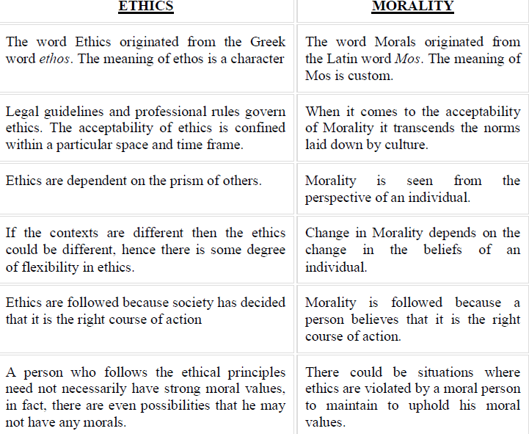
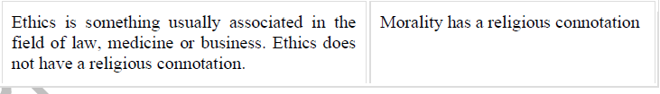

Slide 10
Integrity
A term used to describe a person's level of honesty, moral commitments, and willingness to do what's right.
Employees show integrity to the outside world by following work ethics.
The integrity would increase the self-respect of an individual and also would enable him to command respect from others

Slide 11
Academic Integrity
Academic integrity is the commitment to and demonstration of honest and moral behavior in an academic setting.
Eg: Acknowledge contribution of other people. Failure to provide such acknowledgement is considered plagiarism.
Five Pillars of Academic Integrity:
Honesty
Trust
Fairness
Respect
Responsibility
Notes:
The International Center for Academic Integrity (ICAI)

Slide 12
WORK ETHICS
Work Ethics is a value based on hard work and diligence.
Traditional – Work Hard
more production
Current – Work Smart
quality productivity
Importance of work ethics
Productive work
Cooperation
Individuals with strong work ethic
Will have inculcated principles that guide them in their work behavior.
Leads them to consistent higher productivity.

Slide 13
Basic Work Ethic for an Organization
Uniform rules and regulations.
Communication of the rules and regulation to all employees.
Respect for Employees.
Allow a degree of freedom to employees.
Clear cut salary and promotion policy.
Clear and uniform holiday schedule

Slide 14
How to develop strong work ethic
Step 1: Be professional about your work.
Reliability and honesty.
Deliver best outputs.
Be consistent in delivering good quality work and earn good reputation.
Step 2: Manage your time.
Know your strength and weaknesses.
Set yourself deadlines for delivering even small tasks
Prioritize tasks.
Avoid procrastination.
Avoid negative talk and gossip.

Slide 15
Continued..
Step 3: Keep a balance and deliver consistent high performance work.
Do sport, sleep well, and socialize
Step 4: Develop good work habits
Create and learn habits : Valuing punctuality, time, orderliness etc.
“Do it now” habit
“Do it right” habit

Slide 16
Elements of a strong work ethic
Honesty & Integrity
Alertness
Openness
Respect for others
Reliability and Dependability
Determination and Dedication
Accountability and Responsibility
Confidentiality
Initiative

Slide 17
SERVICE LEARNING
Service-learning refers to learning that actively involves students in a wide range of experiences, which often benefit others and the community, while also advancing the goals of a given curriculum.
It offers direct application of theoretical models.
It allows students to synthesize course material in more meaningful ways.
Common goals includes gaining;
A deeper understanding of the course/curricular content,
A broader appreciation of the discipline and
An enhanced sense of civic responsibility.

Slide 18
Qualities of service-learning
Integrative
Reflective
Contextualized
Strength-Based
Reciprocal
Lifelong

Slide 19



Benefits of Service Learning/Social Learning
Learning Outcomes
Personal Outcomes
Social Outcomes
Career Development
Relationship with the Institution

Slide 20
CIVIC VIRTUE
Civic virtue is morality or a standard of righteous behavior in relationship to a citizen's involvement in society.
Civic virtue is the harvesting of habits important for the success of the community.
Eg: pay tax, follow road safety rules, voting, volunteering, organizing a book group etc.
It often conceived as the dedication of citizens to the common welfare of their community even at the cost of their individual interests.
Civic virtue is not an inherent human quality but needs to be developed.

Slide 21
RESPECT FOR OTHERS
Respect, also called esteem, is a positive feeling or action shown towards someone or something considered important, or held in high esteem or regard.
It is also the process of honouring someone by exhibiting care, concern, or consideration for their needs or feelings.
It conveys a sense of admiration for good or valuable qualities.
Courtesies that show respect may include simple words and phrases like "Thank you" in the West or "Namaste" in the Indian subcontinent, or simple physical signs like a slight bow, a smile, or a simple handshake.

Slide 22
How to Respect Others?
Listening to the other person.
Being empathetic, understanding each other.
Apologizing to each other when we make mistakes.
Keeping other people’s secrets.
Complying with and respecting laws and regulations
Respecting the privacy and intimacy of others.
Respect personal space.
Helping others when it is in our power to do so.
Being grateful.

Slide 23
LIVING PEACEFULLY
To live peacefully, one should install peace within.
Only who are at peace can spread peace.
Self>Family>Workspace>Society>World.
Factors that Promote Peaceful Living
Conducive environment (safe, ventilated, illuminated and comfortable).
Secured job and motivated with ‘recognition and reward’.
Absence of threat or tension by pressure due to limitations of money or time.
Absence of unnecessary interference or disturbance, except as guidelines.
Healthy labour relations and family situations.

Slide 24
Means to be Adopted to Live Peacefully
Order in one’s life (self-regulation, discipline, and duty).
Pure thoughts in one’s soul (loving others, blessing others, friendly, and not criticizing or hurting others by thought, word or deed).
Creativity in one’s head (useful and constructive).
Beauty in one’s heart (love, service, happiness, and peace).
Good health/body (physical strength for service).
Help the needy with head, heart, and hands (charity). Service to the poor is considered holier than the service to God.
Not hurting and torturing others either physically, verbally, or mentally.

Slide 25
CARING
Caring is feeling for others.
Caring means to protect the emotions/feelings of others without causing much damage.
It includes showing respect to the feelings of others, and also respecting and preserving the interests of all others concerned.
Caring is reflected in activities such as friendship, membership in social clubs and professional societies, and through various transactions in the family, fraternity, community, country and in international councils.

Slide 26
SHARING
Sharing means sharing of feelings, ideas, thoughts, resources and profits.
Sharing is voluntary and it cannot be driven by force, but motivated successfully through ethical principles.
Sharing should be genuine, legal, positive, voluntary, and without any expectation in return.
Sharing is ‘charity’ for the humanity, ‘sharing’ is a culture.
It paves the way for peace, prosperity and sustains it.

Slide 27
HONESTY
Honesty is speaking the truth.
Examples of speaking the honest truth means:
Honesty means you do not say things about people that are not true.
Being honest means you admit to your actions, even if you will get in trouble.
Honesty means you explain how a situation really happened.
Being honest means you act in a way that you know is the right thing to do.

Slide 28
Honesty is a virtue, and it is exhibited in two aspects namely,
1. Truthfulness
Truthfulness is to face the responsibilities upon telling truth.
2. Trustworthiness
Trustworthiness is maintaining integrity and taking responsibility for personal performance
Some of the actions of an engineer that leads to dishonesty
Lying
Deliberate deception
Withholding the information
Not seeking the truth
Not maintaining confidentiality
Giving professional judgment under the influence of extraneous factors

Slide 29
COURAGE
Courage is the tendency to accept and face risks and difficult tasks in rational ways.
Self-confidence is the basic requirement to nurture courage.
Types of Courage, based on the types of risks, namely
Physical courage ( Physical strength, including the muscle power )
Social courage (Leadership abilities )
Intellectual courage (Empathy and Sacrifice)

Slide 30
Expressions of Courage
Facing the criticism, owning responsibility, and accepting the mistakes or errors when committed and exposed are the expressions of courage.
Characteristics of courageous people
Perseverance (sustained hard work),
Experimentation (preparedness to face the challenges, that is, unexpected or unintended results),
Involvement (attitude, clear and firm resolve to act), and
Commitment (willing to get into action and to reach the desired goals by any alternative but ethical means).

Slide 31
COOPERATION
It is a team-spirit present with every individual.
Cooperation is activity between two persons or sectors that aims at integration of operations (synergy), while not sacrificing the autonomy of either party.
Cooperation promotes co-ordination and synergy.
The absence of cooperation leads to lack of communication and undue delay between supply, production, marketing, and consumption.
Notes:
Synergy -

Slide 32
The hindrance/impediments to successful cooperation are:
Clash of ego of individuals.
Lack of leadership and motivation.
Conflicts of interests, based on region, religion, language, and caste.
Ignorance and lack of interest.
By careful planning, motivation, leadership, fostering and rewarding team work, professionalism and humanism beyond the ‘divides’, training on appreciation to different cultures, mutual understanding ‘cooperation‘ can be developed and also sustained.

Slide 33
COMMITMENT
Commitment means acceptance of the responsibilities and duties.
Commitment means alignment to goals and adherence to ethical principles during the activities.
Work teams that are committed and cooperative are more likely to achieve the goals the business has set.
Commitment helps :
Maintaining or increasing quality
Reaching or exceeding production targets
Decreasing complaints from team members
Limited conflict between team members
Fewer workplace injuries.

Slide 34
EMPATHY
Sensing what others feel about, without their open talk, is the essence of empathy.
Empathy begins with showing concern, and then obtaining and understanding the feelings of others, from others‘ point of view
The benefits of empathy includes:
Good customer relations
Harmonious labour relations
Good vendor-producer relationship

Slide 35
Characteristics need to be developed by a good leader to practice empathy
Understanding others
Service orientation
Developing others
Leveraging diversity
Political awareness

Slide 36
SELF-CONFIDENCE
Belief in one’s own capabilities, values, and goals, is self-confidence.
Self-confidence is positive attitude, wherein the individual has some positive and realistic view of himself, with respect to the situations in which one gets involved.
The people with self- confidence exhibit courage to get into action and unshakable faith in their abilities, whatever may be their positions.
The self-confidence in a person develops a sense of partnership, respect, and accountability
Helps the organization to obtain maximum ideas, efforts, and guidelines from its employees.

Slide 37
The people with self-confidence have the following characteristics:
A self-assured standing.
Willing to listen to learn from others and adopt (flexibility),
Frank to speak the truth, and
Respect others’ efforts and give due credit.
The factors/sources that shape self-confidence in a person
Heredity (attitudes of parents) and family environment,
Friendship (influence of friends/colleagues),
Influence of superiors/role models, and
Training in the organization

Slide 38
The following methodologies are effective in developing self-confidence in a person:
Encouraging SWOT analysis. By evaluating their strength and weakness, they can anticipate and be prepared to face the results.
Training to evaluate risks and face them (self-acceptance).
Self-talk . It is conditioning the mind for preparing the self to act, without any doubt on his capabilities. This make one accepts himself while still striving for improvement.
Study and group discussion, on the history of leaders and innovators

Slide 39
SOCIAL EXPECTATIONS
Social expectations are ideas that we have of how someone in our social surroundings will behave in the future or in a specific situation.
It is exactly what society expects from you. i.e. how best or how morally you behave in the society.
These social or behavioural expectations greatly influence our own behaviour.

Slide 40
KTU University Questions
PART A (3 MARKS EACH)
1. Distinguish between morality and ethics.
2. List the factors that enhance the self confidence in a person.
3. How does integrity help to build up the value system of a professional?
4. Define the term service learning?
5. Define empathy. What is the difference between empathy and sympathy?
6. What is a civic virtue and how is it related to respect for others?
7. Define empathy and honesty.
8. Briefly explain about morals, values and ethics.

Slide 41
PART B
1.a Explain the qualities of service learning (7).
b. Describe the qualities required live a peaceful life. (7)
2. a. Explain the steps for developing a strong work ethic. (8)
b. Classify courage based on the type of risk. (6)
3.a. How does civic virtues play a vital role in a life of a Professional? (7)
b. Explain the principles required to respect others? (7)
4.a. Explain the different aspects of honesty? (7)
b. Explain the role of Commitment in the life of a Professional?(7)
5.a. Explain the role of caring and sharing in a workplace. (5)
b. How integrity plays a major role in work ethics. Discuss with suitable examples. (9)

Slide 42
6.a. Explain the need of cooperation and commitment. (8)
b. Write a note on “Social Expectations”.(6)
7. a. Classify the relationship between ethical values and law?(10)
b. Compare between caring and sharing. (4)
8. a Exemplify a comprehensive review about integrity and respect for others.(8)
b. Discuss about co-operation and commitment. (6)

